Slide 1
DA1469x AoA Demo Assembly Instructions
V1.0
July 29, 2019

Slide 2
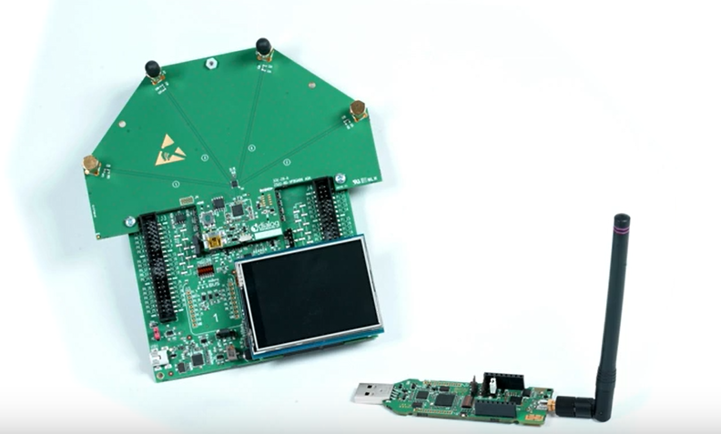
Current AoA Demo
YouTube link: https://www.youtube.com/watch?v=jSDtUOQXJmo
Receiver
Transmitter

Slide 3
AoA Demo Assembly
Objective
You may have received Dialog DA1469x development kit and Antenna boards separately from Dialog.
The instructions in this document will allow you to assemble them so that you can reproduce the demo as shown in the YouTube video in the previous slide.

Slide 4
AoA Demo Components
Hardware Components
Receiver
One 69x pro-kit motherboard, +
69x AoA daughter card plugged in, +
LCD board (Although there is console output with AoA data, the LCD makes it more meaningful)
Transmitter
One 69x USB dongle
LCD
Part number is Adafruit1651 (https://www.mouser.com/ProductDetail/Adafruit/1651?qs=%2Fha2pyFadui%252ByqmMEPPjygZK5phD6F9p2KQ2m%2FKMX2M%3D )
Adding the LCD to DA1469x motherboard will require couple of small reworks.

Slide 5
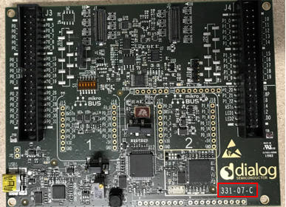
Connecting the LCD board
DA1469x Pro-Kit development kit comes with a motherboard and 69x daughter card.
The rework instructions are for Rev C of the board
Put aside the 69x daughter board
Just take the motherboard

Slide 6
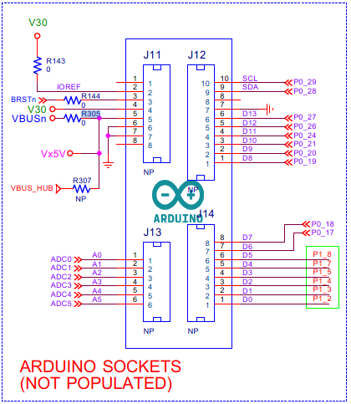
Connecting the LCD board
Remove R305, and put it at R307
Install Sockets: J11, J12, J13, J14
Note:
In this configuration the motherboard needs to be
connected to a pc/laptop using USB mini cable.
DA1469x ProKit Motherboard Schematic
https://www.dialog-semiconductor.com/sites/default/files/da14695-mb-pro_vc-sch.pdf
DA1469x ProKit Documentation:
https://www.dialog-semiconductor.com/products/da14695-development-kit-pro

Slide 7
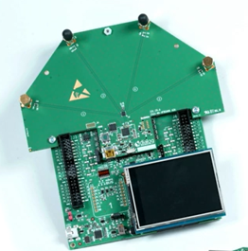
Putting it together
Assembly
Plug in the AoA daughter card to mother board
Plug in the LCD display to the sockets just installed.
Connect the motherboard to a pc/laptop using a USB mini cable
Now we are ready to program the flash

Slide 8
AoA Demo Software
For AoA demo, we currently share the binary images only, no source code provided.
Please note that this is a separate code base from ToF demo.
It is expected that the customer has
Registered on Dialog website,
Downloaded and installed SmartSnippets Studio and the latest SDK
https://www.dialog-semiconductor.com/products/da1469x-product-family

Slide 9
AoA Demo Software Programming
Flash Programming
AoA demo software is provided in binary format. Files are shared via ftp site as communicated via email
Download and unzip the files. Review file readme.md. It has instructions for flash programming. Edit the flash programming command lines to suit your pc environment.
Receiver programming:
The AoA antenna board with DA1469x may already be programmed with AoA software.
If not, execute the scripts to program the Receiver (Sample log attached)
Transmitter programming
Execute the scripts to program the receiver (69x USB dongle)
Sample log attached
Reset both transmitter and receiver boards. Demo should be ready

Slide 10
Thank You !

